Slide 1

Major Project [STMJ600]
Organization Name: Amity University Kolkata
ANUSHA KHALID
MSTAT-4
A90579221004

Slide 2
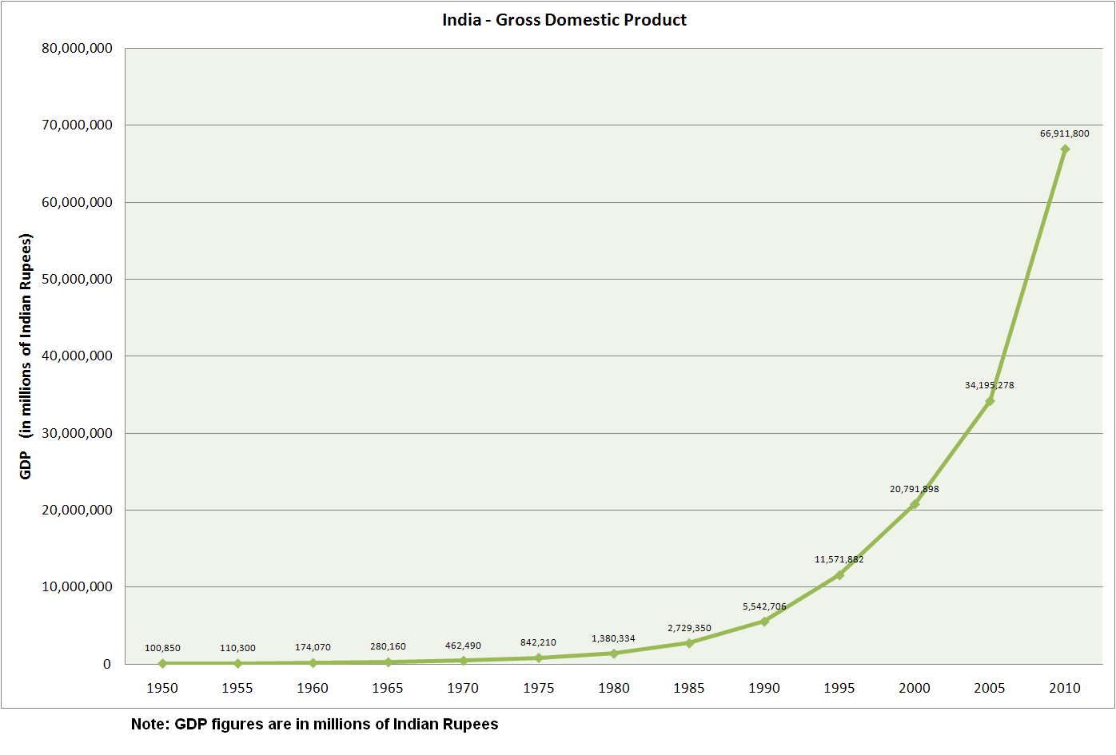
Project Title
Statistical Analysis of factors affecting Economic Growth & Development of India

Slide 3
Objective
GDP is a vital indicator of well-being of a country, we will perform the following:
Examine various factors that impact GDP in India
Identify the most influential variables.
Compare the the pre-COVID and post-Covid periods to determine how the pandemic has affected the Indian economy

Slide 4
Sources of Data
GDP and NSDP: https://en.wikipedia.org/wiki/List_of_Indian_states_and_union_territories_by_GDP
CPI: https://rbidocs.rbi.org.in/rdocs/Publications/PDFs/104T_1911202208425902CB7D4CBBB571FF7F8DA9333B.PDF
GER: https://m.rbi.org.in/scripts/PublicationsView.aspx?id=20666
CBR, CDR, IMR: https://www.indiabudget.gov.in/budget2022-23/economicsurvey/doc/stat/tab82.pdf
Life Expectancy: https://en.wikipedia.org/wiki/List_of_Indian_states_by_life_expectancy_at_birth
HDI: https://en.wikipedia.org/wiki/List_of_Indian_states_and_union_territories_by_Human_Development_Index
Unemployment Rate: https://www.rbi.org.in/Scripts/PublicationsView.aspx?id=20001
GFCF: https://rbidocs.rbi.org.in/rdocs/Publications/PDFs/123T_19112022C242620B11BF4B35B44C80C5F042D09D.PDF
GCF: https://www.rbi.org.in/Scripts/PublicationsView.aspx?id=20774

Slide 5
Dependent Variable
Independent Variables
Gross Domestic Product (GDP)
CPI, GCF, GFCF, Unemployment Rate, CBR, CDR, IMR, Life Expectancy and HDI

Slide 6
Description of Variables Considered
Gross Domestic Product (GDP) and Net State Domestic Product (NSDP) are essential measures of economic activity at the national and state levels, respectively, and have been considered as primary variables.
In this project, we will examine the factors that influence these two measures and create prediction models with them as dependent variables.

Slide 7
Important Variables
1. GDP (Gross Domestic Product) : Measure of total value of goods and services produced within a country during a specific period, typically a year
2. NSDP : (Net State Domestic Product) : Measure of economic output of a state/region
3. CPI (Consumer Price Index) : measures rate of inflation
4. GCF (Gross Capital Formation) : This measures the level of investment in the country’s economy, including both public and private investment.

Slide 8
5. Life Expectancy : Life Expectancy is a statistical measure that indicates the average number of years a person can expect to live.
6. GFCF (Gross Fixed Capital Formation) : level of investment in fixed assets, such as machinery, buildings, and infrastructure.
7. Human Development Index (HDI) : it is a composite statistical measure that was developed by UNDP to assess the level of development of countries around the world.
8. Gross Enrollment Ratio (GER) : Statistical measure used in education to indicate the number of students enrolled in a specific level of education.

Slide 9
9. Infant Mortality Rate(IMR) : statistical measure that represents the number of deaths of infants under one year of age per 1000 live births in a given population, usually within a year.
10. Unemployment Rate: Measure of percentage of labor force that is currently unemployed.
11. Crude Birth Rate (CBR): Measure of the number of live births per 1000 people in a population over a year
12. Crude Death Rate (CDR): Measure of the number of deaths per 1000 people in a population over a year

Slide 10
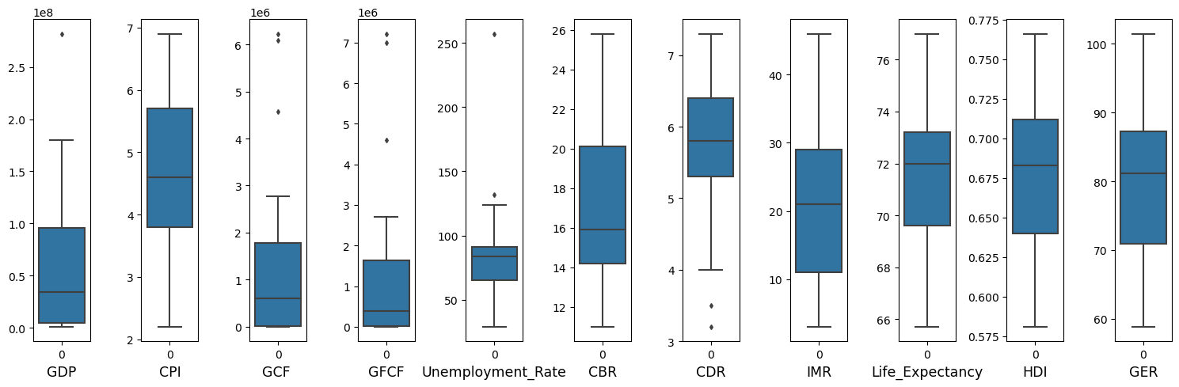
Data Distribution
Based on the boxplots:
Left-skewed: GDP, GCF, GFCF, CBR
Right -skewed: CPI, Unemployment Rate, IMR, Life Expectancy, HDI, GER

Slide 11
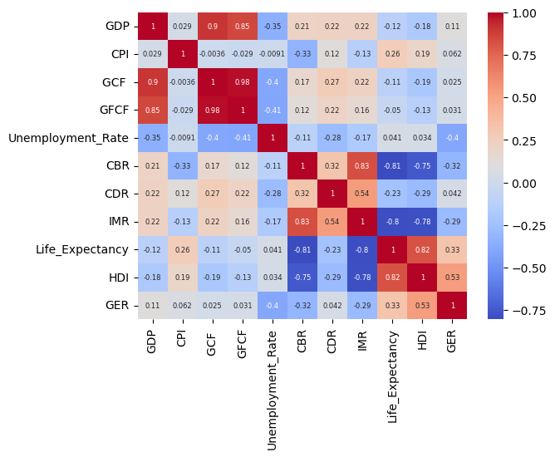
Correlations
GDP has a strong positive correlation GCF (0.9) and GFCF (0.85)
GDP has a positive correlation with CPI, CBR, CDR, IMR and GER
GDP has negative correlation with Unemployment Rate, HDI and Life Expectancy

Slide 12
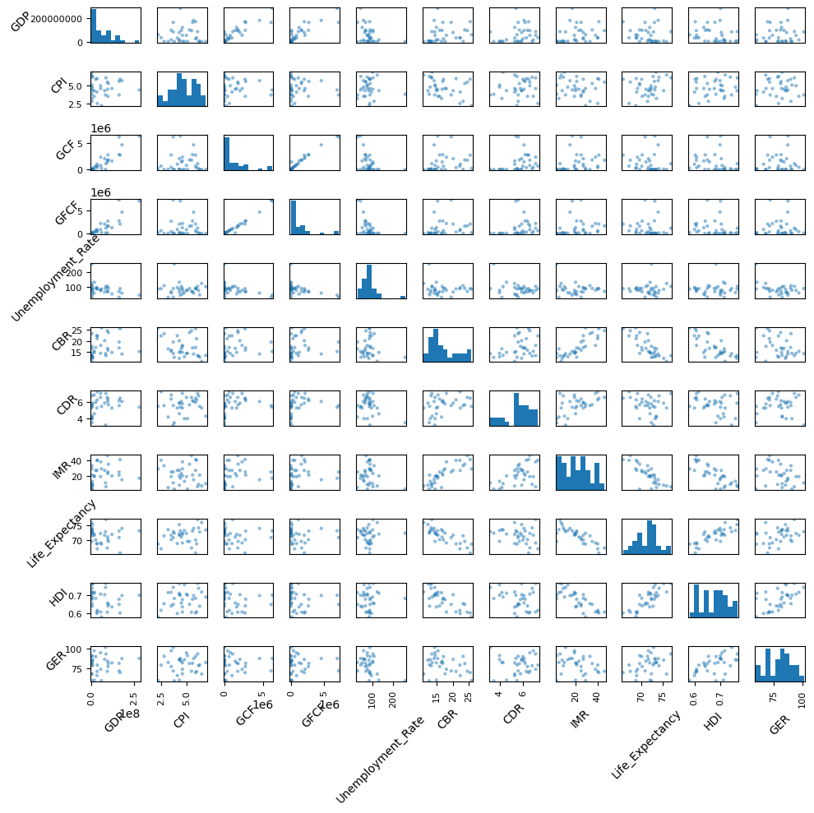
Using pairplot, relationships between all the variables have been visualized.

Slide 13
Methodology Used
Forward elimination and backward elimination are two common methods for feature selection in Machine Learning
Forward elimination is a stepwise approach where the model starts with no predictors and adds variables one by one based on criterion such as improvement in model fit or reduction in error
Backward elimination is a stepwise approach that starts with a full model and removes variables one by one based on a criterion such as decrease in model fit or increase in error.
Forward and backward elimination will be performed for both GDP and NSDP

Slide 14
Factor Analysis is a dimension reduction technique and was performed in order to identify the underlying factors or latent variables.
MANOVA will be performed in order to study two predictors in terms of independent variables.
Amos’s path analysis will be performed, which is a statistical technique used to examine the relationships between variables.

Slide 15
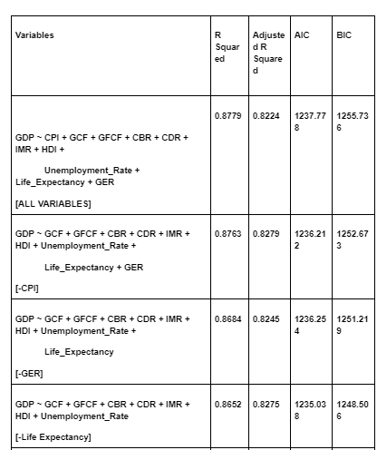
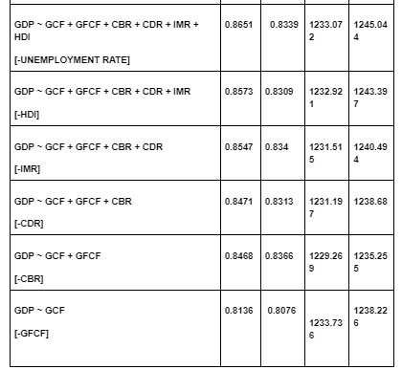
Backward elimination for GDP

Slide 16
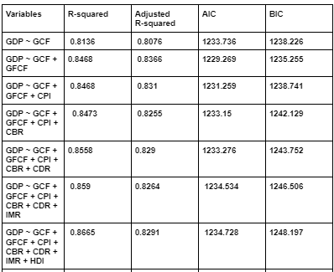
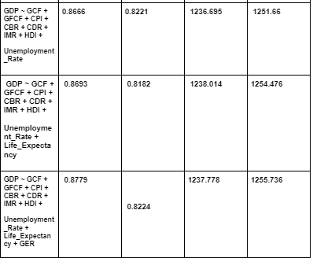
Forward elimination for GDP

Slide 17
Best fit Model for GDP
Based on the information provided in the tables, it appears that the best fit model is the final model that includes all variables. This model has the highest R-squared value of 0.8779, which indicates that it explains a large proportion of the variability in the response variable (GDP) using the predictor variables.
Additionally, the adjusted R-squared value is 0.8224, which suggests that the model is not overfitting and has a good balance between the number of predictor variables and the amount of variability explained in the response variable.
Finally, the AIC and BIC values are relatively low, which suggests that this model is a good balance between model complexity and goodness of fit.
Therefore, the final model with all variables included is likely the best fit model based on the information provided.

Slide 18
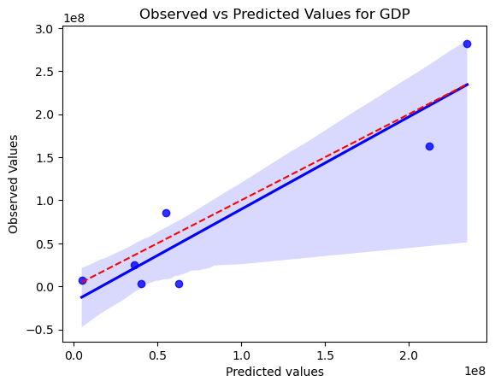
Multiple Linear Regression
GDP ~ CPI + GCF + GFCF + CBR + CDR + IMR + HDI +Unemployment_Rate + Life_Expectancy + GER
Multiple R-squared | 0.8763
Adjusted R-squared | 0.8279
AIC | 1236.212
BIC | 1252.673

Slide 19
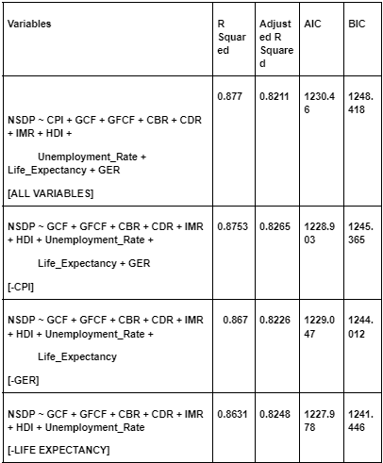
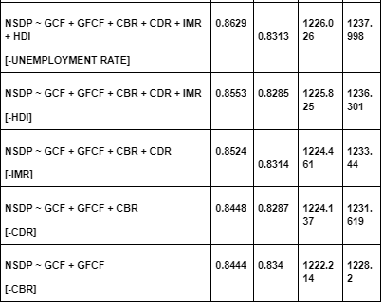
Backward elimination for NSDP

Slide 20
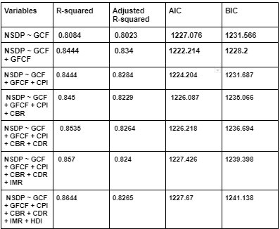
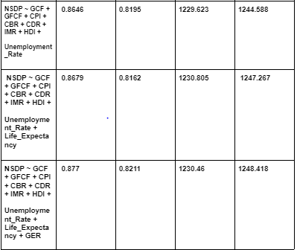
Forward elimination for NSDP

Slide 21
Best fit Model for NSDP
Looking at the tables for backward and forward elimination, it appears that the best fit model for the data would be:
NSDP ~ GCF + GFCF + CPI + CBR + CDR + IMR + HDI + Unemployment_Rate + Life_Expectancy + GER
This model has the highest R-squared value (0.877) and the lowest AIC and BIC values (1230.46 and 1248.418, respectively) among all the models. Therefore, it suggests that this model explains the variation in the dependent variable (NSDP) the best among all the models considered.

Slide 22
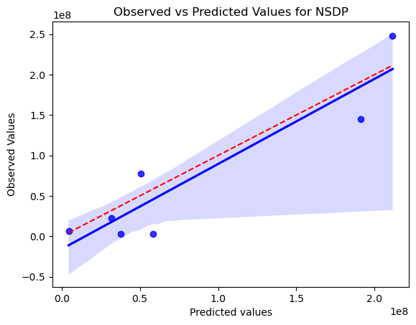
NSDP ~ CPI + GCF + GFCF + CBR + CDR + IMR + HDI+Unemployment_Rate + Life_Expectancy + GER
Multiple R-squared | 0.877
Adjusted R-squared | 0.8211
AIC | 1230.46
BIC | 1248.418

Slide 23
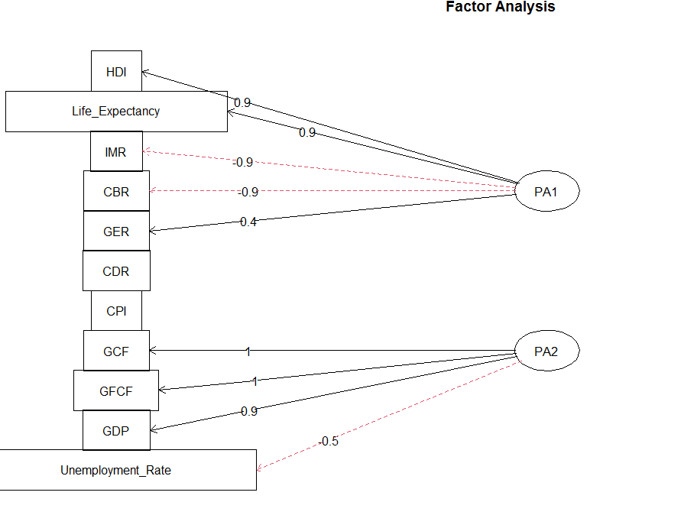
In the diagram, each variable is represented as a circle, and each factor is represented as a line.
Here, we can see a total of 11 variables have been reduced to only 2 variables.

